Slide 1

Spotify Playlist Finder & Social Media
Allegra Papera, Grant Yaniv, Yasir Nemat

Slide 2
Project overview:
Using Spotify's API, we want to create a platform where:
Spotify users who want to discover new music can indicate their preferences for the kinds of music they enjoy listening to or the kinds that they want to discover more of, and each week, our program will follow existing Spotify playlists for them based on those preferences.
Spotify users can enhance the social aspect of music streaming. This will be achieved by providing users with a social platform on our app that expands upon Spotify's existing social features by allowing users to have more control.

Slide 3
System overview
Our application behaves as follows:
Login to Spotify account
Filling out music discovery form
Notified as to which playlists have been followed on notification page
Interaction with music social media aspects
Specialized profile pages and central post feed
Posts are stored into a database through MySQL
Notes:
The application behaves as follows: (1) The user logs into our application by logging in with their Spotify account credentials, giving our application access to Spotify’s database as well as the individual’s Spotify account data (2) The user fills out their Music Discovery Preferences form, then our app will use that information to retrieve a sample of data from Spotify about which playlists fit the user’s preference criteria. Our application will then randomly select certain playlists from this sample, and follow those playlists on the user’s Spotify account. (3) The user will be notified with the Notifications page about the newly followed playlists, as well as any activity such as comments on their posts. (4) The Music Social Media User Profile Pages and Social Media Post Feed will also be updated with information about the playlists that were followed by our app on the user’s Spotify account. (5) Posts added to the Music Social Media User Profile Pages and Social Media Post Feed will be passed to our application’s MySQL Database via a MySQL API.
The system will be compromised of the following functional requirements: Spotify Login, Music Discovery Preferences, Music Social Media User Profile Pages, Social Media Post Feed, and Notifications Page. The Spotify Login will allow our application to access user data from Spotify’s database via the Spotify API. The Music Discovery Preferences feature will interact with Spotify’s music database (via the Spotify API) as it will be used to generate a sample of playlists retrieved from Spotify’s database (via the Spotify API) that match the user’s preferences for music discovery. The Music Social Media User Profile Pages will also retrieve and display user profile data from Spotify’s database (via the Spotify API), in addition to our app’s customizable profile features. The Social Media Post Feed and Notifications Page will not be directly connected to Spotify’s database or its API, but rather they will reflect our app’s actions triggered by our Music Discovery Preferences feature (which does interact directly with the Spotify database via the Spotify API) as well as any in-app behaviors such as writing text posts, album reviews, etc. In-app updates to the Social Media Post Feed and Music Social Media User Profile Pages will be passed to our application’s MySQL Database via a MySQL API for storage.

Slide 4
System overview Continued
The application has the following functional requirements:
Spotify Login
Log in to Spotify account through Spotify API
Music Discovery Preferences
Filling out music form to find playlists via the Spotify API and Spotify database
Expanded User Profiles
Display Spotify user profiles with greater detail
Music Social Media Post Feed
A central location for all user posts, stored in a MySQL database
Notifications Page
The location where followed playlists are sent to the user
Notes:
The application behaves as follows: (1) The user logs into our application by logging in with their Spotify account credentials, giving our application access to Spotify’s database as well as the individual’s Spotify account data (2) The user fills out their Music Discovery Preferences form, then our app will use that information to retrieve a sample of data from Spotify about which playlists fit the user’s preference criteria. Our application will then randomly select certain playlists from this sample, and follow those playlists on the user’s Spotify account. (3) The user will be notified with the Notifications page about the newly followed playlists, as well as any activity such as comments on their posts. (4) The Music Social Media User Profile Pages and Social Media Post Feed will also be updated with information about the playlists that were followed by our app on the user’s Spotify account. (5) Posts added to the Music Social Media User Profile Pages and Social Media Post Feed will be passed to our application’s MySQL Database via a MySQL API.
The system will be compromised of the following functional requirements: Spotify Login, Music Discovery Preferences, Music Social Media User Profile Pages, Social Media Post Feed, and Notifications Page. The Spotify Login will allow our application to access user data from Spotify’s database via the Spotify API. The Music Discovery Preferences feature will interact with Spotify’s music database (via the Spotify API) as it will be used to generate a sample of playlists retrieved from Spotify’s database (via the Spotify API) that match the user’s preferences for music discovery. The Music Social Media User Profile Pages will also retrieve and display user profile data from Spotify’s database (via the Spotify API), in addition to our app’s customizable profile features. The Social Media Post Feed and Notifications Page will not be directly connected to Spotify’s database or its API, but rather they will reflect our app’s actions triggered by our Music Discovery Preferences feature (which does interact directly with the Spotify database via the Spotify API) as well as any in-app behaviors such as writing text posts, album reviews, etc. In-app updates to the Social Media Post Feed and Music Social Media User Profile Pages will be passed to our application’s MySQL Database via a MySQL API for storage.

Slide 5
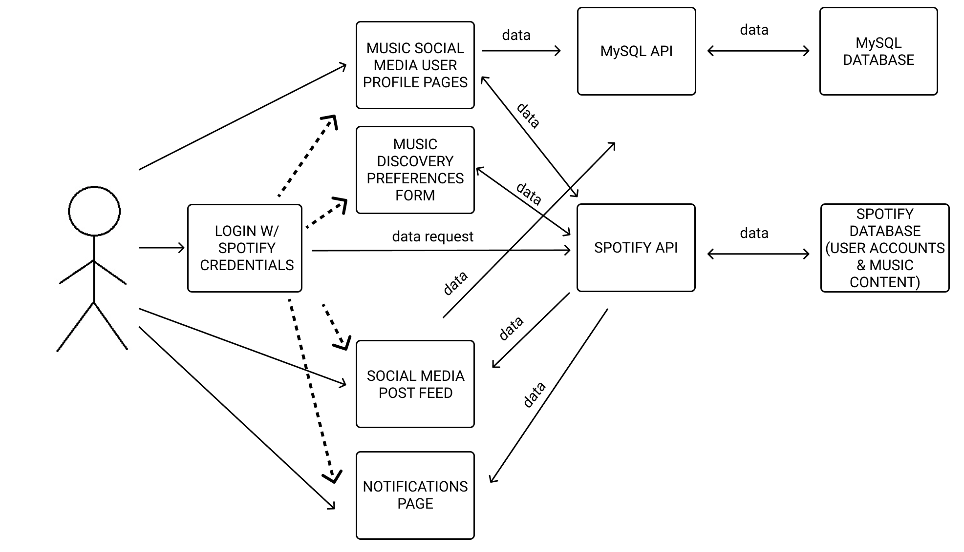
System diagram

Slide 6
Architectural style – pipes and filters
Pipes and Filters is an architectural style in which filters take inputted data which is then outputted by certain processes, and that output becomes the input to another process. Pipes serve as connectors for the stream of data being transformed.
The architectural style of this application is Pipes and Filters because of how data is constantly being transformed from one output to the input of another process.
One filter is the Music Discovery Preferences Form that takes input from the user about the kinds of playlists they are looking for, is then outputted in the form of followed playlists on the notification page.
The Spotify API servers both as a Pipe, to connect streams of data being transformed such as followed playlists and user profile information, and as a filter to help follow playlists.
Notes:
The application is designed using the Pipes and Filters architectural style. Pipes and Filters has components called filters which perform transformations on data and process the input they receive, as well as pipes which serve as connectors for the stream of data being transformed. Specifically, filters will receive input about the user’s Music Discovery Preferences, and it will transform that data into a selection of playlists that could match the user’s preferences. A smaller random selection of those playlists that are not currently followed by the user will be chosen to be followed on the user’s Spotify account. The Spotify API will serve as both a Pipe and a Filter, as it will be used to inform Spotify’s DB of the user’s preferences, and it will also be used to sample the playlists that match those preferences.

Slide 7
DESIGN Pattern
Based on this type of application and system we will be creating we believe that the Façade design pattern would be most applicable because it will give us the unified interface we are looking for on this project.
Gives us a simplified and straightforward view of the functionality of our system
Makes it easier for users to do what they want to do most such as discover playlists and share posts with friends and followers.
Our web-client for this application is the Façade in this case, with the Spotify API, Spotify API, and MySQL working in the background.

Slide 8
Actor identification
Notes:
The human actors included in our Spotify Playlist Finder & Social Media platform is the user (who must login with their Spotify account credentials), who uses the application primarily to interact with their Spotify accounts (requesting new music to listen to via the Music Discovery Preferences Form) and to make social media posts related to their music listening activity on Spotify. The system will support interaction with non-human actors, the Spotify API and the MySQL API to allow for interaction between the application and the Spotify User Account Database and our MySQL Database containing data related to our app’s Social Media Feed aspect.

Slide 9
frameworks
We will be using the Spotify API to be able to use the functionality of some Spotify features, such as their playlist catalog and user profiles, in order to lay the foundation of our application. We do not need to create the Spotify API, we just need to take advantage the existing Spotify API’s functionalities. We will be able to make Spotify API calls using JavaScript code.
We will also be using the Node.js framework, as suggested by the Spotify API Developer Guidebook, to handle the back-end and server-side of this application since our front-end logic will be created using JavaScript.

Slide 10
Sequence diagram

Slide 11
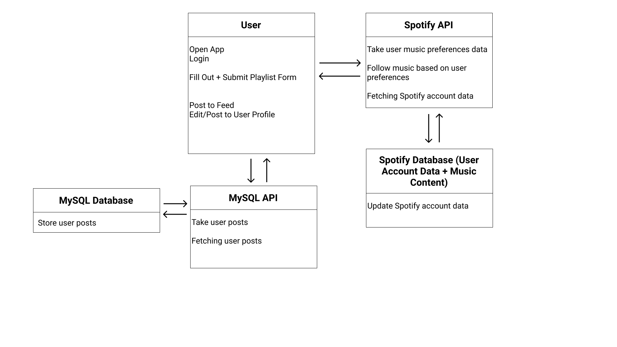
Class diagram

Slide 12
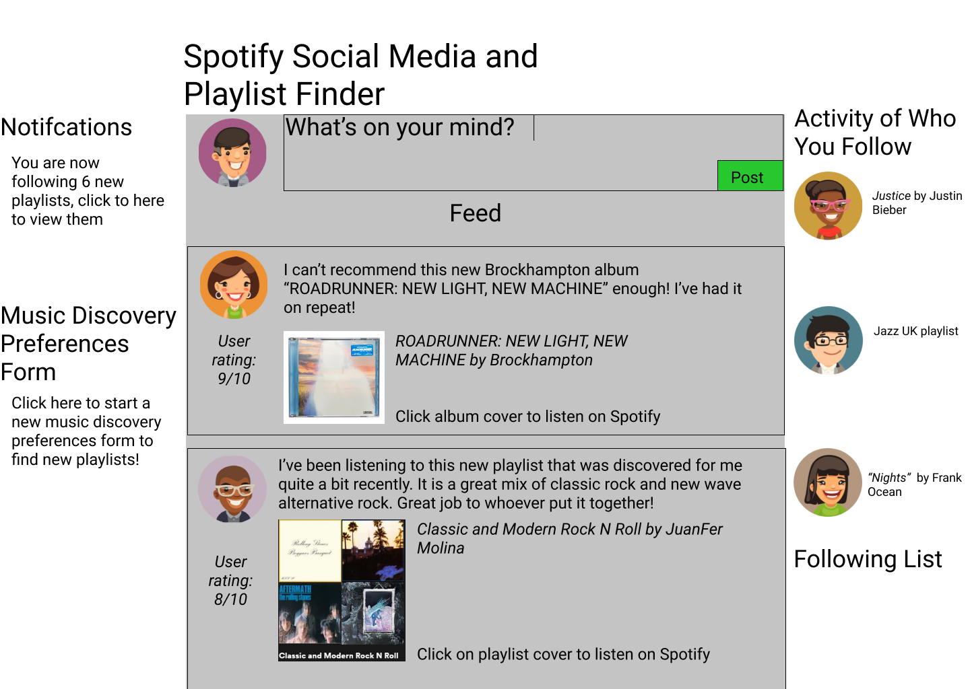
A basic mockup

Slide 13
GitHub link

Slide 14
Thank You for Listening
Any Questions?

